Slide 1



Introduction to Electronic Navigation
NN220-08
SEANAV I United States Naval Academy
NN220 – Fundamentals of Navigation– Updated May 2023
Operations Officer I HMS PROTECTOR A173 I The Ice Patrol Ship

Slide 2
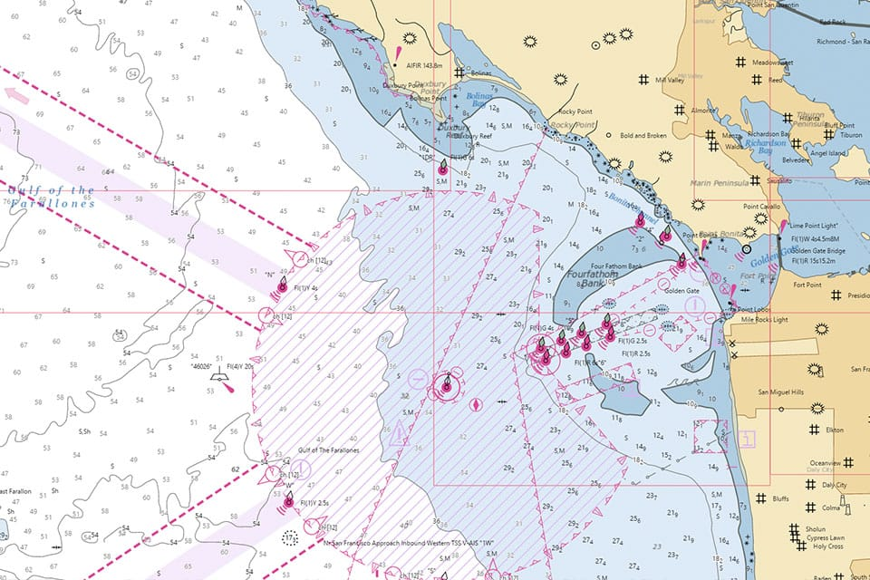
References
-The American Practical Navigator, Pub. No. 9, Bowditch, VOL. 1, 2019 Edition -Surface Ship Navigation Department Organizations and Regulations Manual (NAVDORM), COMNAVSURFPAC/COMNAVAIRPAC/COMNAVAIRLANT/COMNAVSURFLANT INSTRUCTION 3530.4 series
SEANAV I United States Naval Academy
NN220 – Fundamentals of Navigation
Operations Officer I HMS PROTECTOR A173 I The Ice Patrol Ship

Slide 3
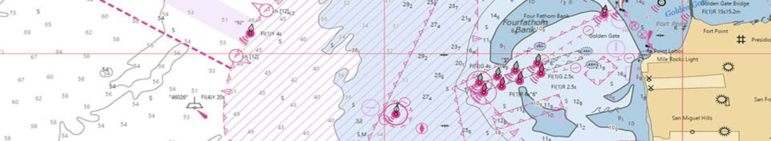
Enabling Objectives
1 – DESCRIBE E-Nav. 2 - INTRODUCE an Electronic Chart System (ECS). 3 - INTRODUCE an Electronic Chart Display Information System (ECDIS). 4 - DESCRIBE ECS performance standards. 5 - DESCRIBE ECDIS performance standards. 6 - INTRODUCE ECDIS-N. 7 - DEMONSTRATE The features of ECDIS-N. 8 - INTRODUCE What an Electronic Chart is. 9 - DESCRIBE the legal aspects of using Electronic Charts. 10 - INTRODUCE Raster Nautical Charts (RNCs). 11 - INTRODUCE Electronic Nautical Charts (ENCs) as Vector Charts. 12 - INTRODUCE Digital Nautical Charts (DNCs) as Vector Charts for the USN. 13 - DESCRIBE Integrated Bridge Systems (IBS) and Navigation Sensor System Interface (NAVSSI). 14 - DESCRIBE how to correct electronic charts to the most recent NTM and/or LNM. 15 - DESCRIBE The advantages and disadvantages of Electronic Navigation Systems, including ECS, ECDIS and ECDIS-N. 16 - UNDERSTAND the use of Time and satellites to determine a Line of Position (LOP). 17 - DESCRIBE Trilateration and the need of 3 or more LOPs to generate a GPS fix. 18 - DESCRIBE Standard Positioning Service (SPS) and Precise Positioning Service (SPS). 19 - DESCRIBE the 3 segments of GPS. 20 - DEFINE the term Figure of Merit (FOM).
SEANAV I United States Naval Academy
NN220 – Fundamentals of Navigation
Operations Officer I HMS PROTECTOR A173 I The Ice Patrol Ship

Slide 4
Electronic Navigation
https://www.youtube.com/watch?v=16PMYLVWVOI
SEANAV I United States Naval Academy
NN220 – Fundamentals of Navigation
Operations Officer I HMS PROTECTOR A173 I The Ice Patrol Ship

Slide 5
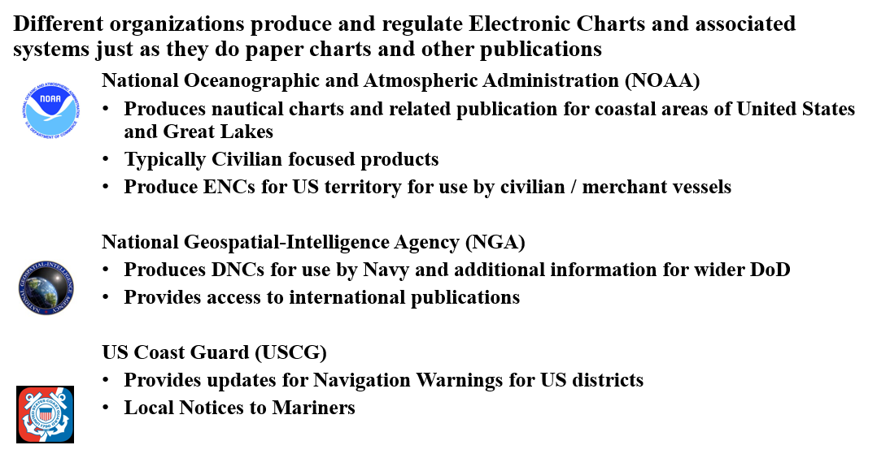
U.S. Regulation
SEANAV I United States Naval Academy
NN220 – Fundamentals of Navigation
Operations Officer I HMS PROTECTOR A173 I The Ice Patrol Ship

Slide 6
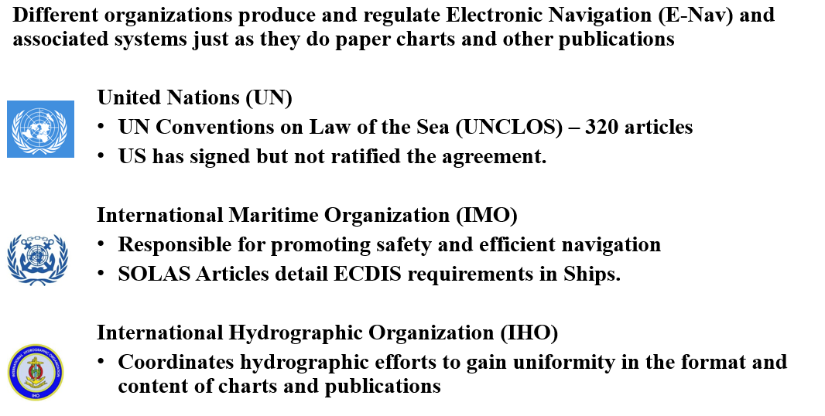
International Regulation
SEANAV I United States Naval Academy
NN220 – Fundamentals of Navigation
Operations Officer I HMS PROTECTOR A173 I The Ice Patrol Ship

Slide 7
Electronic Navigation
-Electronic Navigation (E-Nav) is described by the IMO as: “the harmonized collection, integration, exchange, presentation and analysis of marine information on board and ashore by electronic means to enhance berth to berth navigation and related services for safety and security at sea and protection of the marine environment.”
-In early 1990’s IMO adopted performance standards for Electronic Charting.
-In 2000, IMO adopted revised SOLAS Regulation V/19 for carriage for shipborne navigation systems and Electronic Chart Display Information Systems.
-In 2009, IMO amended V/19 to make carriage of ECDIS mandatory in ships and vessels of certain classes:
All newly built passenger ships over 500 gt.
All newly built cargo ships over 3000gt.
Phased introduction of fitting requirements to existing shipping.
SEANAV I United States Naval Academy
NN220 – Fundamentals of Navigation
Operations Officer I HMS PROTECTOR A173 I The Ice Patrol Ship

Slide 8
Electronic Navigation
-E-Nav is not a static concept. User requirements continue to evolve with technology. The IMO provides a Strategy Implementation Plan to provide a vision for future E-Nav requirements including: Regulation Equipment and Technology Training Charting and Publications Maritime reporting – Vessel Traffic Services / Global Maritime Distress
IMO future objectives for E-Nav are:
S1: improved, harmonized and user-friendly bridge design;
S2: means for standardized and automated reporting;
S3: improved reliability, resilience and integrity of bridge equipment and navigation information;
S4: integration and presentation of available information in graphical displays received via communication equipment; and
S5: improved communication of VTS Service Portfolio (not limited to VTS stations).
SEANAV I United States Naval Academy
NN220 – Fundamentals of Navigation
Operations Officer I HMS PROTECTOR A173 I The Ice Patrol Ship

Slide 9
Electronic Navigation
In Electronic Navigation, two primary systems are used:
Electronic Charting System (ECS)
Electronic Chart Display and Information System (ECDIS)
SEANAV I United States Naval Academy
NN220 – Fundamentals of Navigation
Operations Officer I HMS PROTECTOR A173 I The Ice Patrol Ship

Slide 10
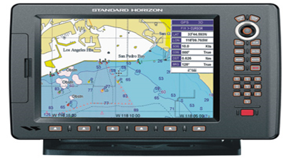
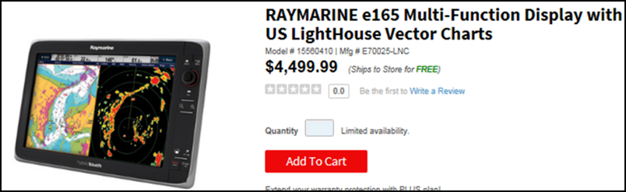
Electronic Charting Systems
-An Electronic Charting System (ECS) is a computer assisted navigation system capable of displaying electronic nautical charts and the vessel’s position in near real time.
-It has a basic level of capability and does not meet IMO standards for navigation, though it is commercially produced for all mariners.
-For the US Navy, this system can only be used for situational awareness and not navigation.
-You will typically find this system on:
Pleasure Crafts
Sailing Vessels
Small FVs
SEANAV I United States Naval Academy
NN220 – Fundamentals of Navigation
Operations Officer I HMS PROTECTOR A173 I The Ice Patrol Ship

Slide 11
Electronic Chart Display and Information System
-An Electronic Chart Display and Information System (ECDIS) is a navigation information system which with adequate back-up arrangements can be accepted as complying with the up-to-date chart required by the 1974 SOLAS Convention, by displaying:
Selected information from a electronic navigational chart
Positional information from navigation sensors
Route Planning and Route Monitoring
Additional navigation-related information
-It has an advanced level of capability and meets the IMO standards for navigation, specifically hardware, software and electronic charting requirements.
-Mandated equipment in vessels of certain types/sizes.
-Fitted into all new commercial/military vessels as required by the IMO.
-Integrates a broad range of sensors.
-Provides positional redundancy by allowing you to fix positional information on means other than GPS, such as:
Visual LOPs
RADAR LOPs
Celestial LOPs
SEANAV I United States Naval Academy
NN220 – Fundamentals of Navigation
Operations Officer I HMS PROTECTOR A173 I The Ice Patrol Ship

Slide 12
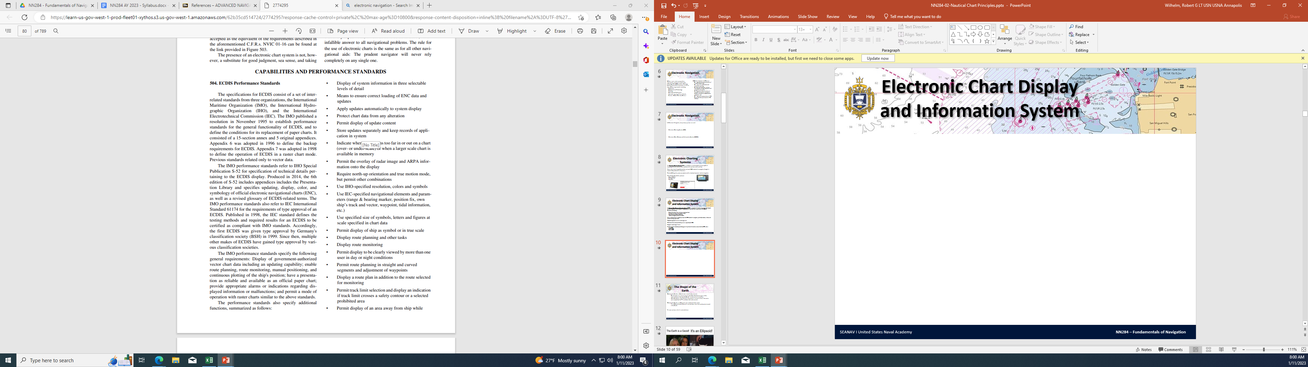
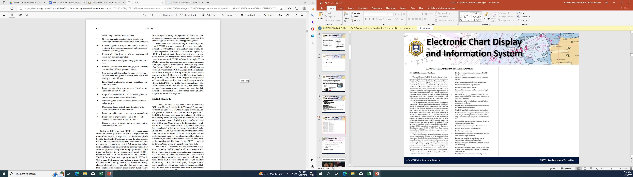
Electronic Chart Display and Information System
SEANAV I United States Naval Academy
NN220 – Fundamentals of Navigation
Operations Officer I HMS PROTECTOR A173 I The Ice Patrol Ship

Slide 13
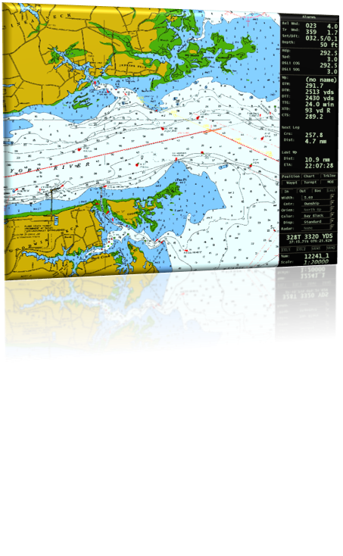
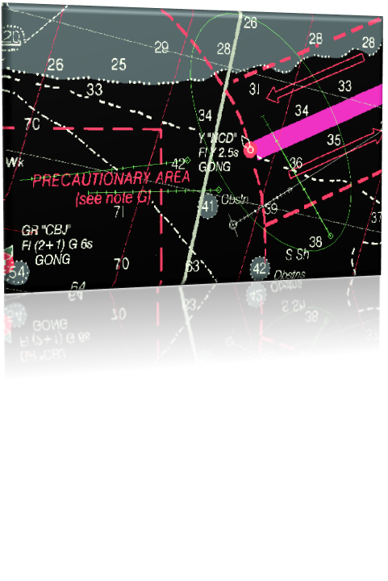
ECDIS Functional Requirements
Display
-Present information to IMO approved standards for color / symbology.
Customize Display
-Adjust display and safety settings to meet ship / vessel characteristics.
Customizable Scale
-Will indicate if zoomed into correct scale (1:1)
Fused information
-Display Radar and AIS information.
Adequate redundancy and Back Up
-Must have multiple stations in event of failure.
-Uninterruptable Power Supply ( UPS) – battery back up to Ship’s own generation for ECDIS.
SEANAV I United States Naval Academy
NN220 – Fundamentals of Navigation
Operations Officer I HMS PROTECTOR A173 I The Ice Patrol Ship

Slide 14
ECDIS Functional Requirements
Route Planning
-Informs of navigational hazards plotted along route.
-Automatic or manual chart updates.
Route Monitoring
-Displays Time/Distance labels on track.
-Displays a set area for Look Ahead to inform user of hazards.
Automatic Grounding Avoidance
-Alarms for hazards.
Recording: BLACK BOX
-Track and user inputs
Tests, Alarms and Indications
-System Malfunction
SEANAV I United States Naval Academy
NN220 – Fundamentals of Navigation
Operations Officer I HMS PROTECTOR A173 I The Ice Patrol Ship

Slide 15
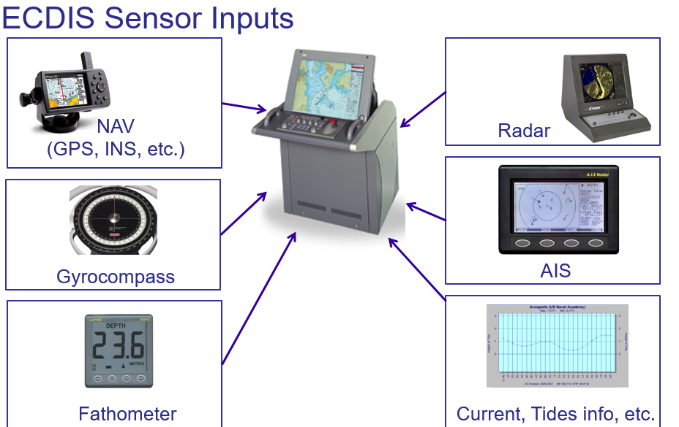

Slide 16
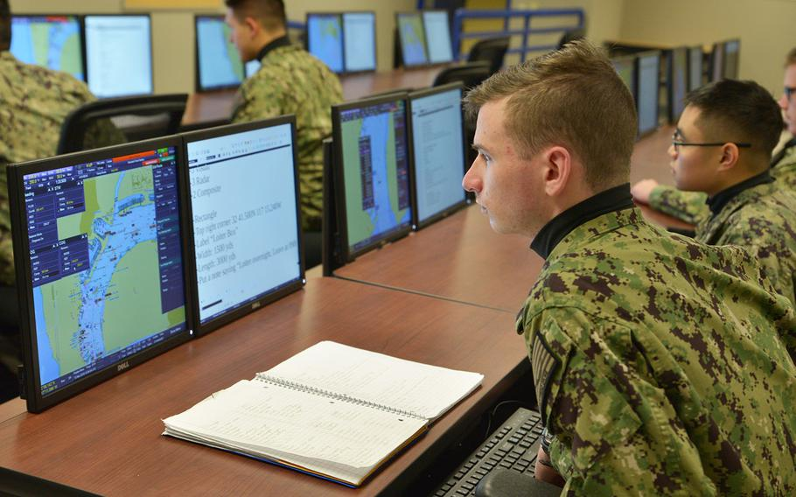
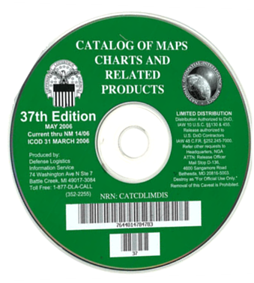
Electronic Chart Display and Information System-NAVY
-In 1998, US Navy issued a policy to establish minimum ECDIS standards for the US Navy, dubbed ECDIS-N.
-ECDIS-N meets IMO standards, but has additional features for use by the Navy, to include:
Display RADAR, visual and celestial navigation fix information.
System-to-system interoperability including integration with Ship Command Systems.
Read and display Digital Nautical Charts (DNC), which are produced for the DoD by NGA.
-Voyage Management System (VMS), Electronic Chart Precise Integrated Navigation System (ECPINS) and Navigation Sensor System Interface (NAVSSI) are the only software that complies with ECDIS-N requirements.
-Additionally, this directive called for a transition of the Fleet from SNCs to Electronic Navigation.
SEANAV I United States Naval Academy
NN220 – Fundamentals of Navigation
Operations Officer I HMS PROTECTOR A173 I The Ice Patrol Ship

Slide 17
ECDIS-N Features
Examples of ECDIS Features
SEANAV I United States Naval Academy
NN220 – Fundamentals of Navigation
Operations Officer I HMS PROTECTOR A173 I The Ice Patrol Ship

Slide 18
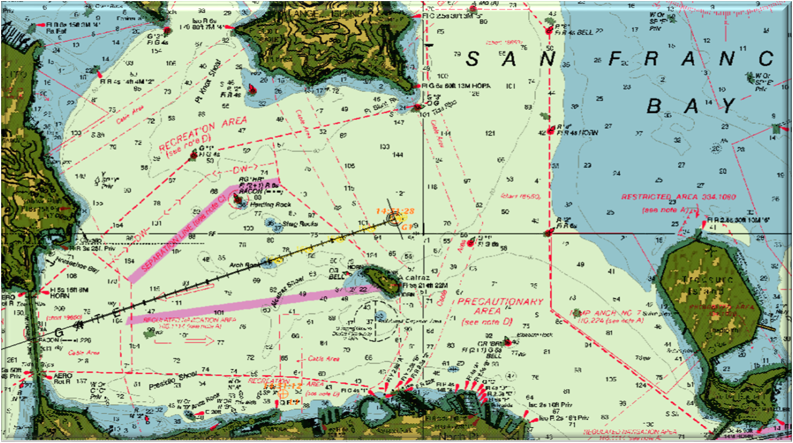
ECDIS Features
RADAR Image Overlay
SEANAV I United States Naval Academy
NN220 – Fundamentals of Navigation
Operations Officer I HMS PROTECTOR A173 I The Ice Patrol Ship

Slide 19
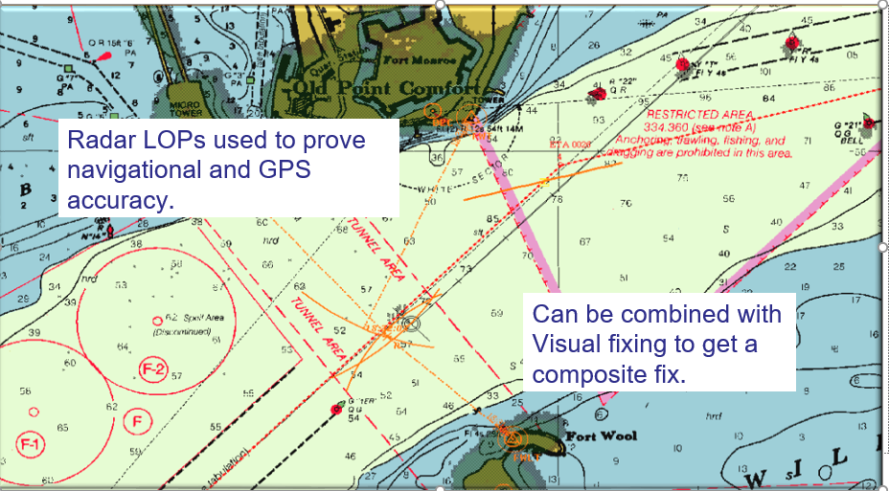
ECDIS Features
LOP Plotting for Positional Redundancy
SEANAV I United States Naval Academy
NN220 – Fundamentals of Navigation
Operations Officer I HMS PROTECTOR A173 I The Ice Patrol Ship

Slide 20

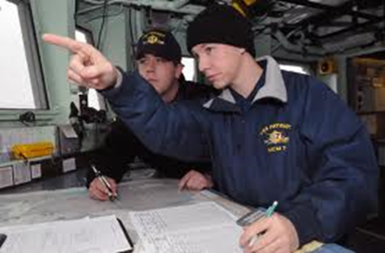
ECDIS Features
PILOTING GUIDANCE
Automatically calculates:
Cross Track Error
Provides recommended course to steer accounting for set/drift
Monitors / alarms on nearest hazard
Will calculate and monitor Turn Bearings / Ranges from navigation aids
Integrates depth through the fathometer
Calculates distance and time to turn
SEANAV I United States Naval Academy
NN220 – Fundamentals of Navigation
Operations Officer I HMS PROTECTOR A173 I The Ice Patrol Ship

Slide 21
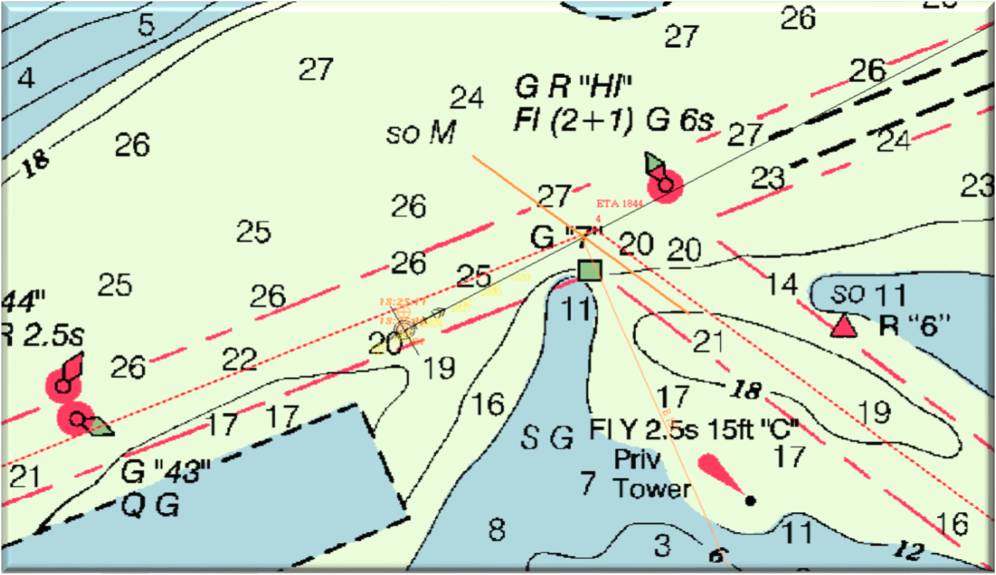
ECDIS Features
Piloting Guidance – Turn Bearings
SEANAV I United States Naval Academy
NN220 – Fundamentals of Navigation
Operations Officer I HMS PROTECTOR A173 I The Ice Patrol Ship

Slide 22
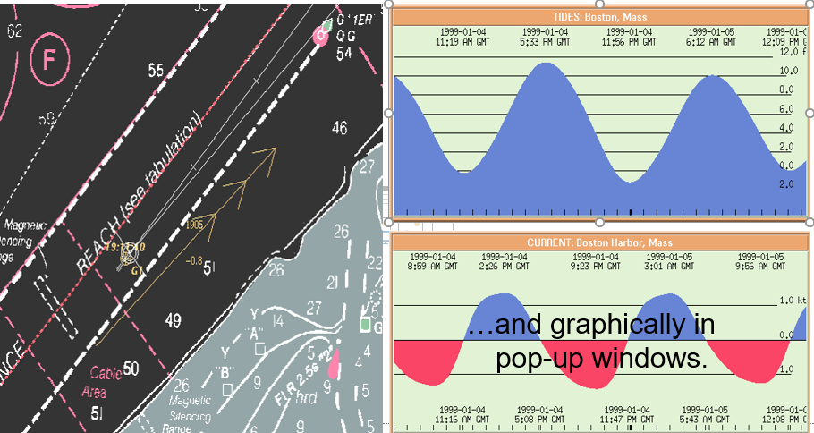
ECDIS Features
Tide and Current Information
SEANAV I United States Naval Academy
NN220 – Fundamentals of Navigation
Operations Officer I HMS PROTECTOR A173 I The Ice Patrol Ship

Slide 23
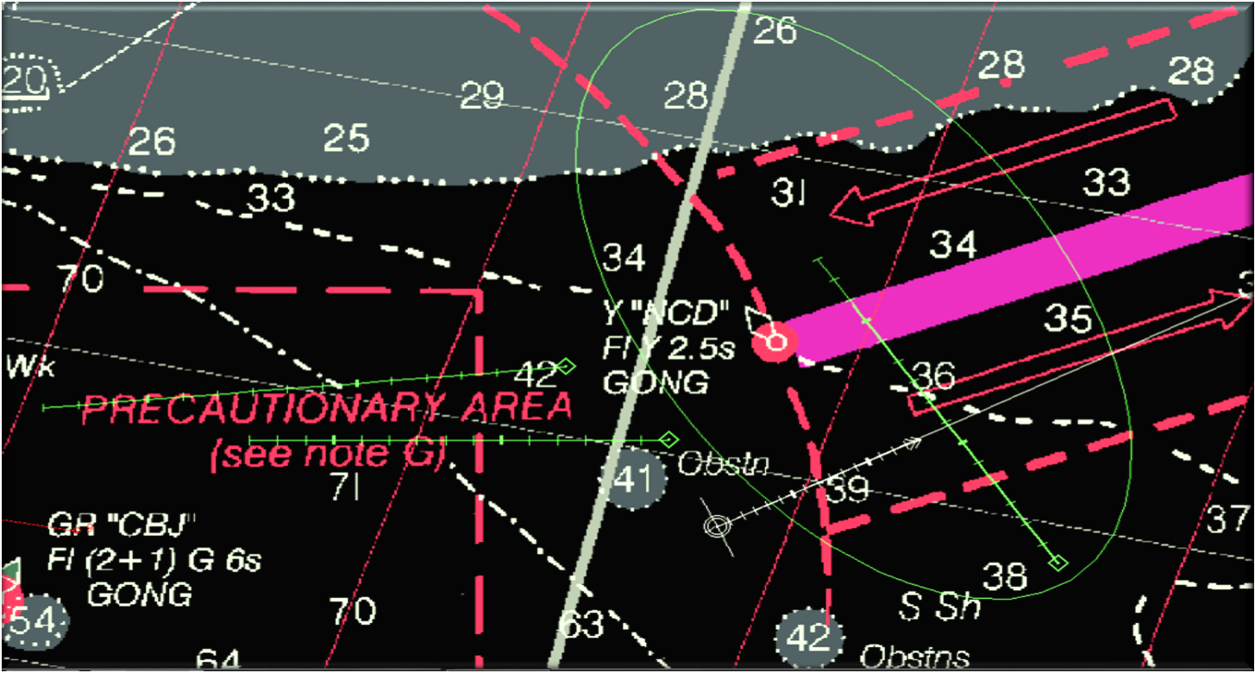
ECDIS-N Features
Collision Avoidance
SEANAV I United States Naval Academy
NN220 – Fundamentals of Navigation
Operations Officer I HMS PROTECTOR A173 I The Ice Patrol Ship

Slide 24
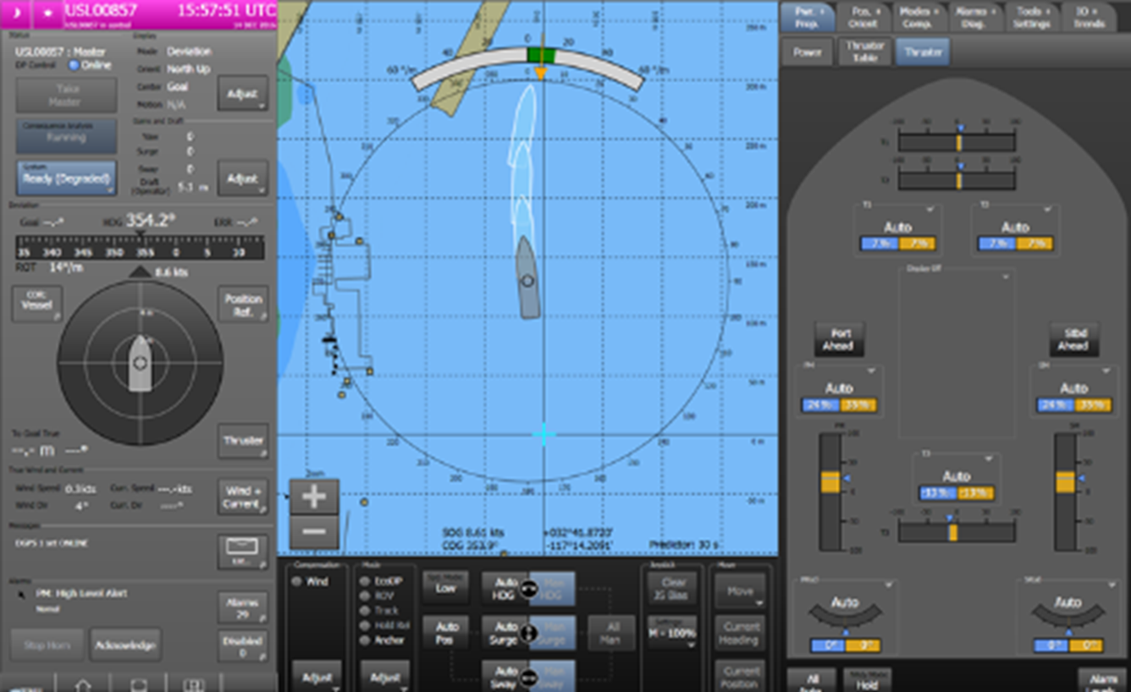
ECDIS-N Features
Future Position Estimate
SEANAV I United States Naval Academy
NN220 – Fundamentals of Navigation
Operations Officer I HMS PROTECTOR A173 I The Ice Patrol Ship

Slide 25
NAVDORM Policy on ECDIS-N
-Details US Navy Type Commander policies, procedures and organizational standards for use and operation of an ECDIS-N, including VMS.
-NAVDORM policy specifies:
A loss of GPS is not considered a loss of ECDIS.
At no time will control stations (Bridge/CIC) revert to paper charts as the primary means of navigation.
In the case of loss of all ECDIS nodes on the bridge, the Ship is authorized to utilize the Emergency Navigation Laptop (ENL) as primary plot.
SEANAV I United States Naval Academy
NN220 – Fundamentals of Navigation
Operations Officer I HMS PROTECTOR A173 I The Ice Patrol Ship

Slide 26
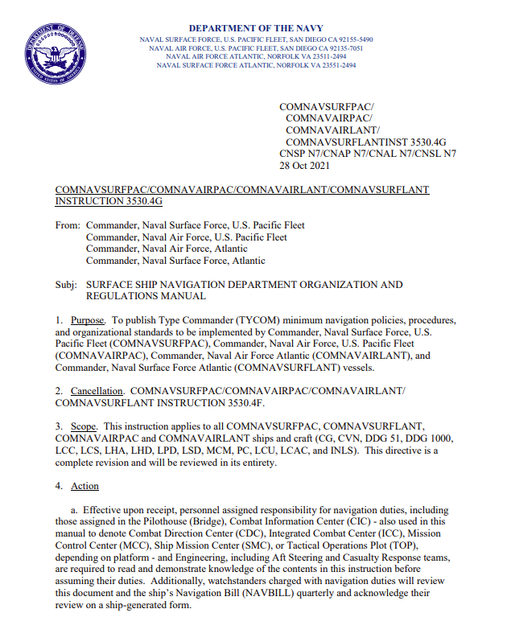
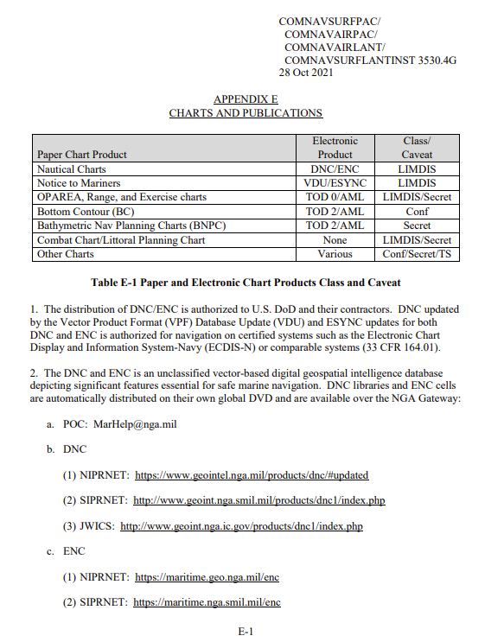
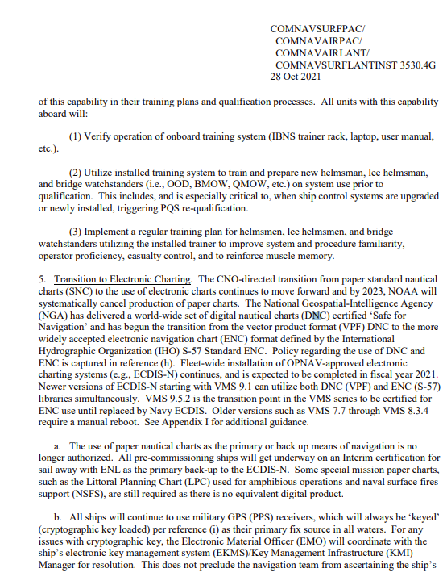

Slide 27
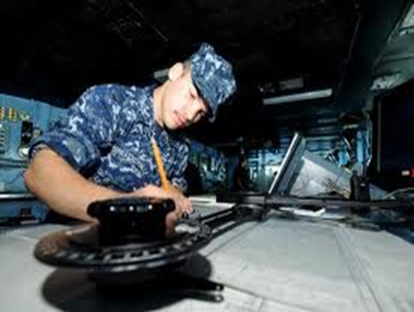
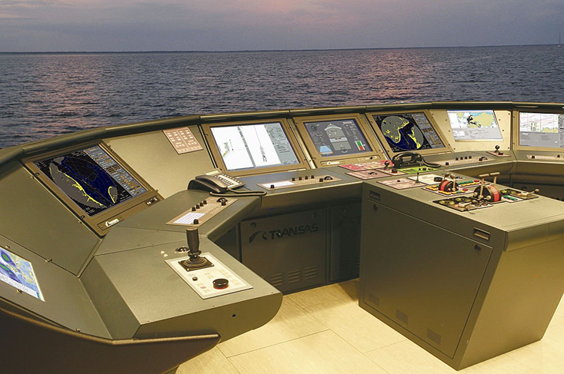
Advantages of ECDIS
Real time position positioning presented visually to User.
Automated plotting (DR / EP) including when GPS not available.
Reduced Manning
Improved Safety
Enhanced Command and Control
Increased awareness in Reduced Visibility
SEANAV I United States Naval Academy
NN220 – Fundamentals of Navigation
Operations Officer I HMS PROTECTOR A173 I The Ice Patrol Ship

Slide 28
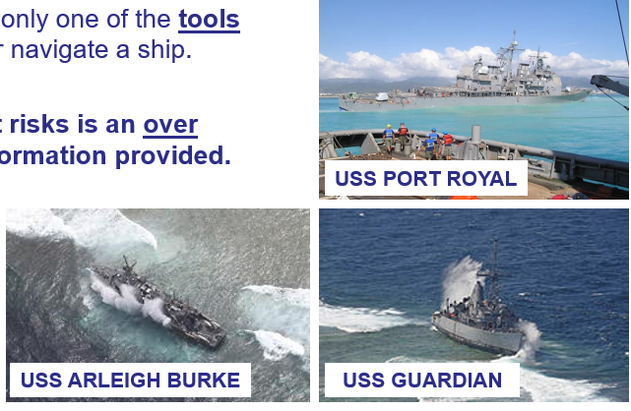

Disadvantages of ECDIS
ECDIS / ECDIS-N is only one of the many tools that helps a mariner navigate a ship.
One of the biggest risks is an OVER RELIANCE on the information provided, without properly vetting it.
SEANAV I United States Naval Academy
NN220 – Fundamentals of Navigation
Operations Officer I HMS PROTECTOR A173 I The Ice Patrol Ship

Slide 29
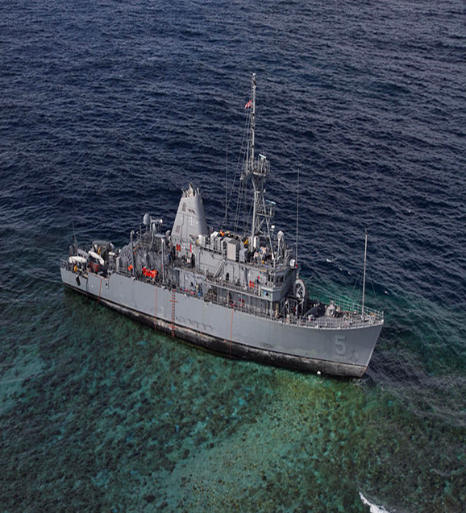
Disadvantages of ECDIS
Poor GPS performance including Spoofing / Jamming will impact positional accuracy if not checked.
ECDIS/ECDIS-N malfunction – Windows based system. It will crash!
Installation/setup errors
ENC compilation errors (e.g. Datums)
Chart (errors, omissions, out-dated)
Human error - the computer is only as good as the inputs… “Garbage in is garbage out!”
SEANAV I United States Naval Academy
NN220 – Fundamentals of Navigation
Operations Officer I HMS PROTECTOR A173 I The Ice Patrol Ship

Slide 30
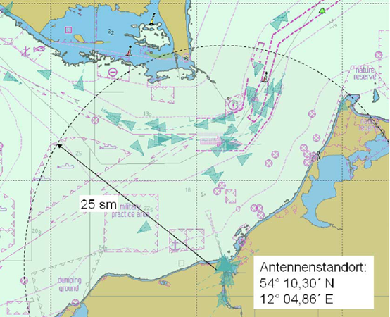
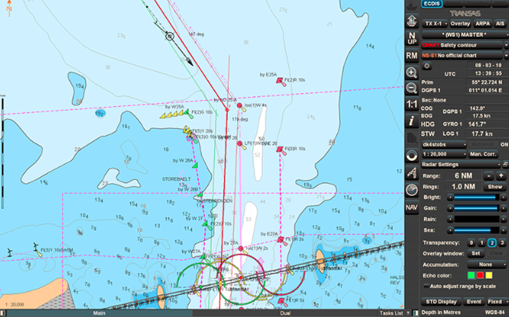
Electronic Charts
-Electronic charts are representations of navigational data encoded in a computer-usable format.
-Computer-generated display provides accurate pictorial presentation of information.
-Real time information can be presented on top of the chart, including GPS, Radar and AIS positional information.
-Electronic Charting is used by both ECS and ECDIS systems.
SEANAV I United States Naval Academy
NN220 – Fundamentals of Navigation
Operations Officer I HMS PROTECTOR A173 I The Ice Patrol Ship

Slide 31
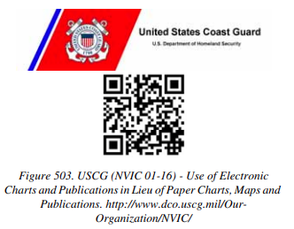
Legal Aspects of Using Electronic Charts
-Requirements for carriage of charts is found in SOLAS Chapter 5.
-States that “All ships shall carry adequate and up-to-date charts necessary for the intended voyage.”
-As technology has developed, international law has been amended to set standards for electronic charts.
SEANAV I United States Naval Academy
NN220 – Fundamentals of Navigation
Operations Officer I HMS PROTECTOR A173 I The Ice Patrol Ship

Slide 32
Electronic Charts
-ECDIS is approved to use TWO types of electronic charts:
Raster Charts (RNCs)
Vector Charts (ENCs and DNCs)
SEANAV I United States Naval Academy
NN220 – Fundamentals of Navigation
Operations Officer I HMS PROTECTOR A173 I The Ice Patrol Ship

Slide 33
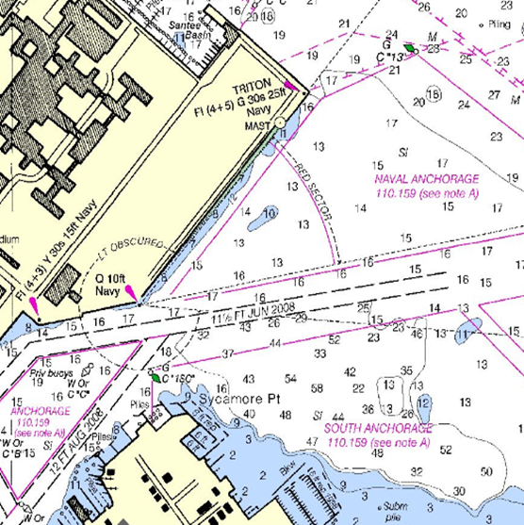
Raster Charts (RNC)
-Raster Charts (RNCs) are a digitized image of chart.
-They are basically a picture of an SNC that has been scanned and uploaded for use on a navigation system.
-Raster Charts cannot take the place of paper charts since they lack features required by IMO.
-Real time information, including GPS position, can be displayed on RNCs. However no further information is available beyond what is displayed.
-Can only be used for Navigation where standardized Electronic Nautical Charts are not available.
-When used in ECDIS, your system is technically regarded as an ECS and is for situational awareness only.
SEANAV I United States Naval Academy
NN220 – Fundamentals of Navigation
Operations Officer I HMS PROTECTOR A173 I The Ice Patrol Ship

Slide 34
Advantages/Disadvantages of Raster Charts
Advantages
-Cheap.
-Readily available.
-Limited RAM space needed.
Disadvantages
-Updates must be applied manually.
-Zooming degrades quality.
-Not interactive.
-Cannot change individual elements.
SEANAV I United States Naval Academy
NN220 – Fundamentals of Navigation
Operations Officer I HMS PROTECTOR A173 I The Ice Patrol Ship

Slide 35
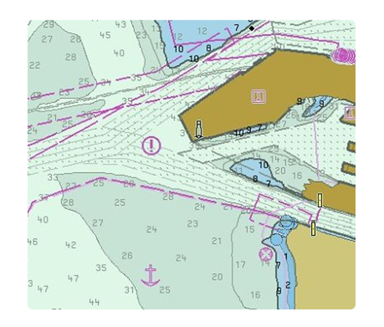
Vector Charts
-Vector Charts are electronic charts whose data is organized into many separate files and layers.
-Contains graphic files and programs to produce certain symbols, points, lines and areas with associated colors, texts and other chart elements.
-Designed to be highly interactive.
-The preferred electronic chart to be used on ECDIS systems.
-Data is produced by governmental bodies.
-Can be updated relatively easily with update files, CDs or thumb drives.
-Two types: Electronic Nautical Charts (ENC) and Digital Nautical Charts (DNC).
SEANAV I United States Naval Academy
NN220 – Fundamentals of Navigation
Operations Officer I HMS PROTECTOR A173 I The Ice Patrol Ship

Slide 36
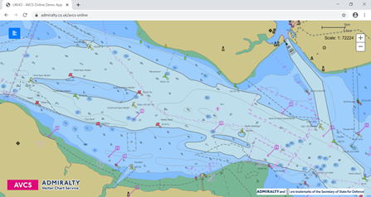
Electronic Nautical Charts (ENC)
-Electronic Nautical Charts (ENC) are vector charts that conform to the S-57 data standard.
-Developed by governmental agencies such as NOAA and the UKHO, following the IMO/IHO ENC produce specifications.
-Used by merchant fleet and the vast majority of the world’s navies.
-Is compatible with VMS.
SEANAV I United States Naval Academy
NN220 – Fundamentals of Navigation
Operations Officer I HMS PROTECTOR A173 I The Ice Patrol Ship

Slide 37
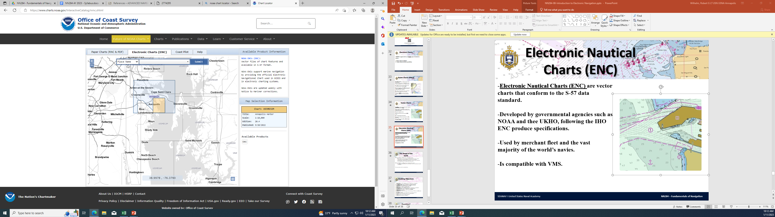
Electronic Nautical Charts (ENC)
SEANAV I United States Naval Academy
NN220 – Fundamentals of Navigation
Operations Officer I HMS PROTECTOR A173 I The Ice Patrol Ship

Slide 38
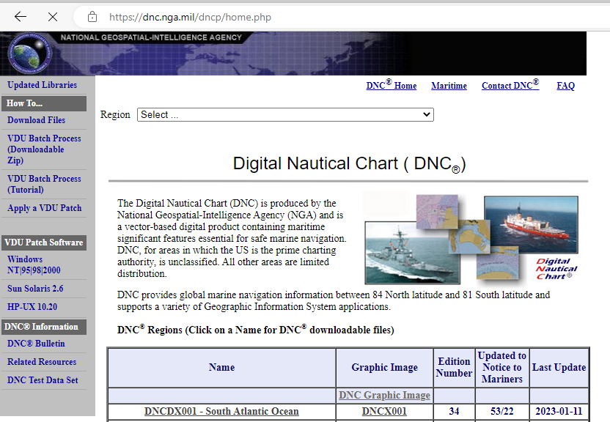
Digital Nautical Charts (DNC)
-Digital Nautical Charts (DNC) are vector charts that conform to the DOD Vector Product Format (VPF) standard.
-Developed by NGA for DOD use.
-Used by the US Navy.
-Include additional data such as more detailed bathymetry for military operating areas.
-Are IMO/IHO compliant and therefore safe for navigation.
-Some DNCs may have security classification.
SEANAV I United States Naval Academy
NN220 – Fundamentals of Navigation
Operations Officer I HMS PROTECTOR A173 I The Ice Patrol Ship

Slide 39
Digital Nautical Charts (DNC)
-DNCs have global coverage.
-DNC cells are divided into four categories based on chart scale (the amount of area the chart covers).
General (smallest scale, largest area) – open ocean
Coastal – East / West coast. Limited topographical / physical features.
Approach – more coastal detail and affiliated to specific harbors
Harbor (largest scale, smallest area) - Affiliated with specific harbors
-Small scale charts cover a large area, but do not contain a great amount of detail – General / Coastal charts.
-Large scale charts cover a small area, but have the most amount of details – Approach / Harbor charts.
SEANAV I United States Naval Academy
NN220 – Fundamentals of Navigation
Operations Officer I HMS PROTECTOR A173 I The Ice Patrol Ship

Slide 40
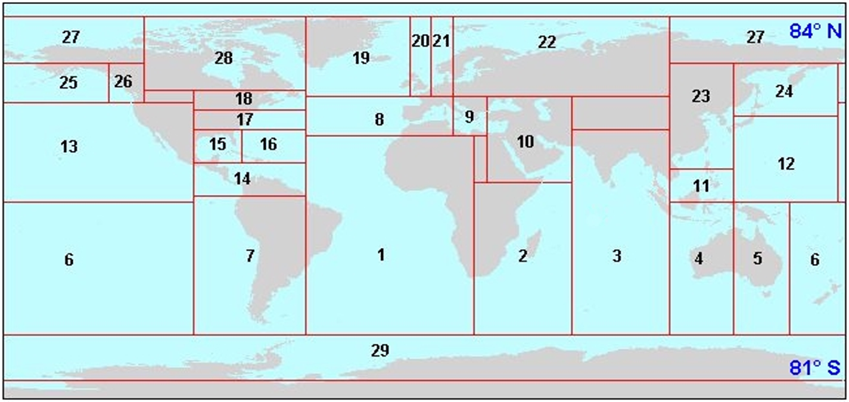
Digital Nautical Charts (DNC)
-29 regions: Global coverage between 84°N and 81°S.
-Regions come in CD format delivered to the ship.
SEANAV I United States Naval Academy
NN220 – Fundamentals of Navigation
Operations Officer I HMS PROTECTOR A173 I The Ice Patrol Ship

Slide 41
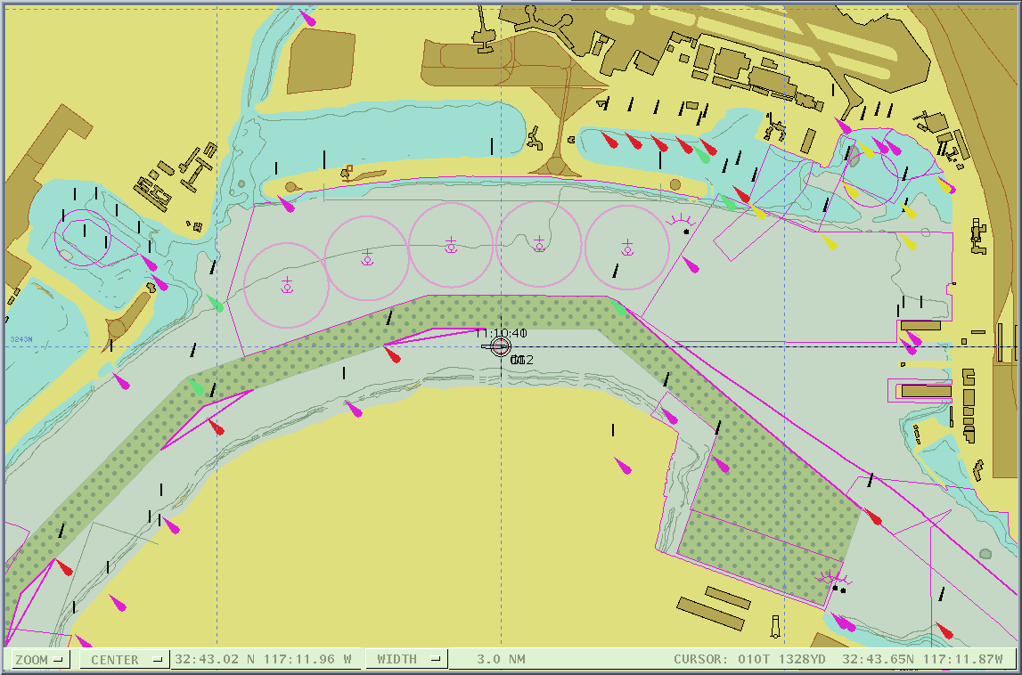
DNC
Standard Display with Depth Contours
The user defines what features are necessary!!!

Slide 42
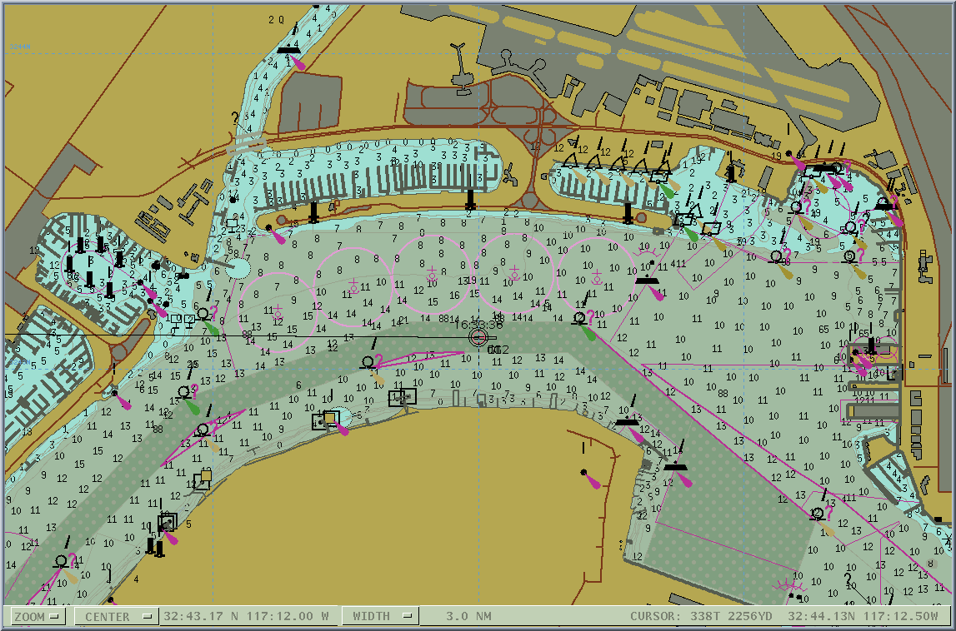
DNC
Standard Display with Spot Soundings
The user defines what features are necessary!!!

Slide 43
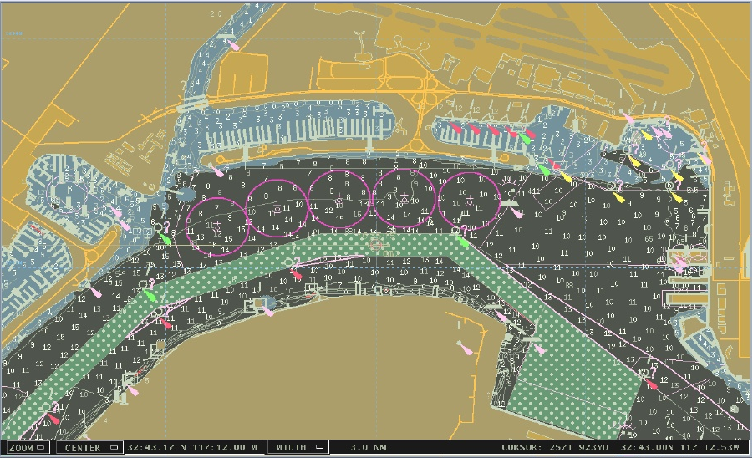
DNC
Night Standard Display with Depth Contours
The user defines what features are necessary!!!

Slide 44
Advantages/Disadvantages of Vector Charts
Advantages
-More detailed information.
-Allows the User to customize the display for the mission. System will identify hazards.
-Zooming reveals details.
-Chart corrections easily applied.
Disadvantages
-Complex, expensive and time-consuming to produce.
-Need more powerful hardware to run multiple charts.
SEANAV I United States Naval Academy
NN220 – Fundamentals of Navigation
Operations Officer I HMS PROTECTOR A173 I The Ice Patrol Ship

Slide 45
Integrated Bridge Systems
-A combination of equipment and software that use interconnected controls and displays to present a comprehensive suite of navigational information to the mariner is called an Integrated Bridge System (IBS).
-An IBS typically consists of at least:
Dual ECDIS installation-one master and the other as backup and route planning station
Dual RADAR/ARPA installation
CONN Display
DGPS positioning
Ship’s speed measuring system
Auto-pilot and gyrocompass system
Full Global Maritime Distress and Safety System (GMDSS) installed
SEANAV I United States Naval Academy
NN220 – Fundamentals of Navigation
Operations Officer I HMS PROTECTOR A173 I The Ice Patrol Ship

Slide 46
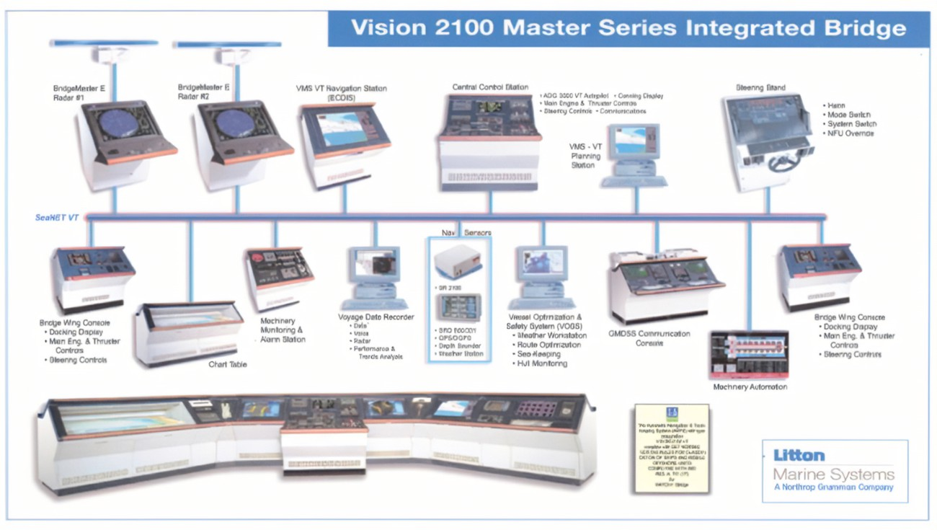
Integrated Bridge Systems
-A combination of equipment and software that use interconnected controls and displays to present a comprehensive suite of navigational information to the mariner is called an Integrated Bridge System (IBS).
-An IBS typically consists of at least:
Dual ECDIS installation-one master and the other as backup and route planning station
Dual RADAR/ARPA installation
CONN Display
DGPS positioning
Ship’s speed measuring system
Auto-pilot and gyrocompass system
Full Global Maritime Distress and Safety System (GMDSS) installed
SEANAV I United States Naval Academy
NN220 – Fundamentals of Navigation
Operations Officer I HMS PROTECTOR A173 I The Ice Patrol Ship

Slide 47
Navigation Sensor System Interface (NAVSSI)
-NAVSSI is a State-of-the-Art Integrated Shipboard Navigation System developed by NCCOSC and Naval Sea Combat System Engineering Station (NSCSES) under the joint direction of the Space and Naval Warfare Systems Command (SPAWAR) and the Naval Sea Systems Command (NAVSEA).
-The system provides a major upgrade in the Navy’s Navigation capability. It meets the fleet requirement to automatically accept and process data from the Global Positioning System (GPS) and other ship Navigation sensors and send precise, uniform, real-time position, velocity, almanac and time data to the Navigator, Combat Systems and Command, Control, Communications, Computers, and Intelligence (C41) systems.
-US Navy’s version of IBS.
-Provides more navigation sensor integration to all of the ship’s command systems.
SEANAV I United States Naval Academy
NN220 – Fundamentals of Navigation
Operations Officer I HMS PROTECTOR A173 I The Ice Patrol Ship

Slide 48
Correcting Electronic Charts
-ENC updates are provided through the distributing agency (NOAA, UKHO, etc).
-NOAA ENC updates can be downloaded from the website and applied directly to the ECDIS node.
-ENC download page will provide the date the ENC region was last updated!
SEANAV I United States Naval Academy
NN220 – Fundamentals of Navigation
Operations Officer I HMS PROTECTOR A173 I The Ice Patrol Ship

Slide 49
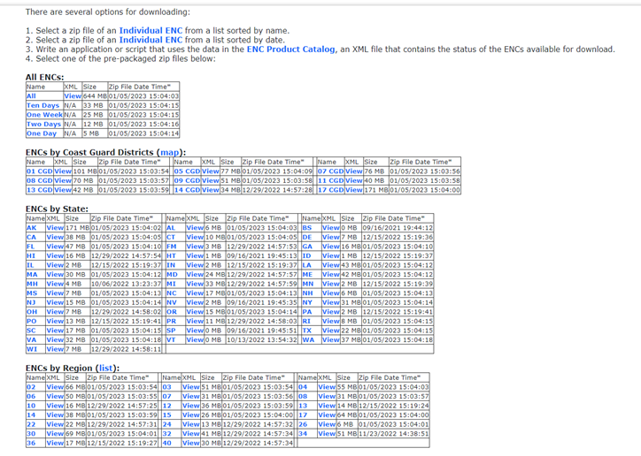
Correcting Electronic Charts
This ENC region is corrected thru 29DEC22!
SEANAV I United States Naval Academy
NN220 – Fundamentals of Navigation
Operations Officer I HMS PROTECTOR A173 I The Ice Patrol Ship

Slide 50
Correcting Electronic Charts
-DNC updates are provided through NGA.
-NGA produces the VPF Vector Database Update (VDU) to correct DNCs.
-Performs comparison of previously installed database, so latest release of the baseline edition must be already installed!
SEANAV I United States Naval Academy
NN220 – Fundamentals of Navigation
Operations Officer I HMS PROTECTOR A173 I The Ice Patrol Ship

Slide 51
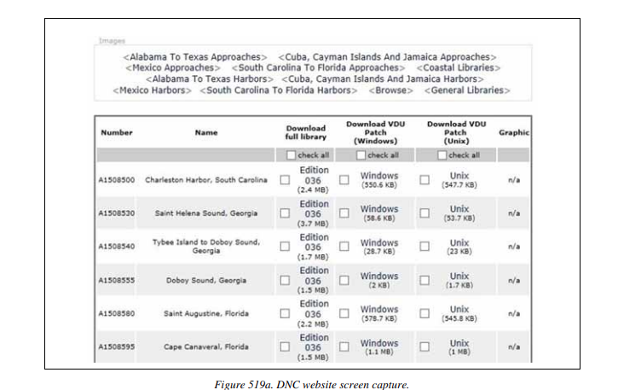
Correcting Electronic Charts
SEANAV I United States Naval Academy
NN220 – Fundamentals of Navigation
Operations Officer I HMS PROTECTOR A173 I The Ice Patrol Ship

Slide 52
Satellite Navigation
-Per the NAVDORM, Global Positioning System (GPS) fixes remains the primary position source for all phases of navigation.
-GPS is the primary navigation system of the U.S. government.
-GPS integrates into ECDIS, providing real-time positional updates on the display screen.
-GPS is the premier Global Navigation Satellite System (GNSS).
-Other GNSS systems include BeiDou (China), GLONASS (Russia), Galileo (Europe), IRNSS (India), Quasi-Zenith Satellite System (Japan).
SEANAV I United States Naval Academy
NN220 – Fundamentals of Navigation
Operations Officer I HMS PROTECTOR A173 I The Ice Patrol Ship

Slide 53
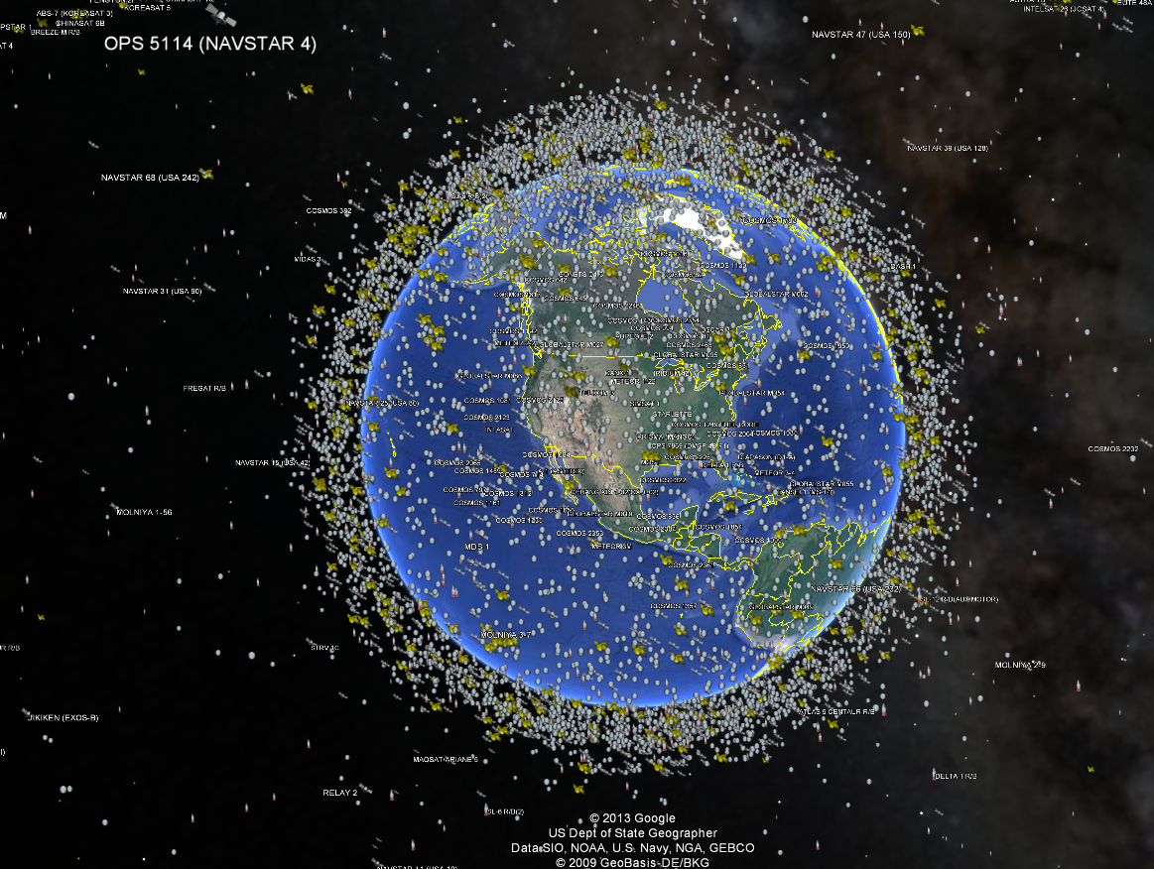

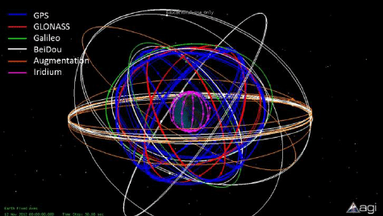
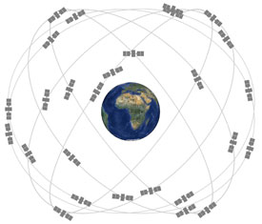

What are the 3 Segments of NAVSTAR GPS?
Satellites are 12,600nm above Earth’s surface.
But note the height of BeiDou (China)!
Very high compared to most commercial satellites.
Improves efficiency of coverage requiring less satellites in network.
Improves survivability; difficult but not impossible for Peer competitors to target and destroy.
Most other GNSS share similar orbit.
SEANAV I United States Naval Academy
NN310 - Advanced Navigation (NAV_2)
Operations Officer I HMS PROTECTOR A173 I The Ice Patrol Ship

Slide 54
GPS
-GPS provides users with accurate, continuous worldwide, all-weather, common-grid, three dimensional positioning and navigation information.
-To obtain a 3D navigation solution of position (latitude, longitude and altitude) and time, (four unknowns), four satellites must be used.
-Three satellites used will result in a 2D fix and will omit altitude information.
SEANAV I United States Naval Academy
NN220 – Fundamentals of Navigation
Operations Officer I HMS PROTECTOR A173 I The Ice Patrol Ship

Slide 55
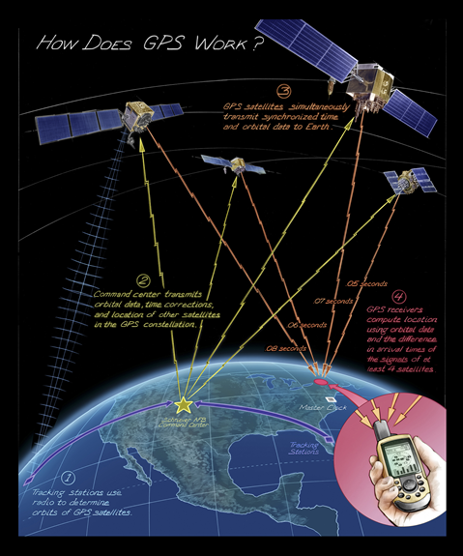
GPS Lines of Position
-GPS works with the basic math of:
Distance = Velocity x Time
-Every satellite within the GPS constellation transmits a unique, time stamped signal.
-Radio waves (which GPS transmits) travel at a known speed of 162,000nm per second.
-If I know:
The time the signal left the satellite…
The time the signal reached my receiver…
The speed of the signal…
I can determine my distance from the satellite.
-This generates a 3-Dimensional Range LOP!
SEANAV I United States Naval Academy
NN220 – Fundamentals of Navigation
Operations Officer I HMS PROTECTOR A173 I The Ice Patrol Ship

Slide 56

GPS Lines of Position
-Just like a range LOP, we know we are somewhere on this sphere, because our distance from the satellite can exist in a 3D space around the satellite.
-With an additional 3 satellites, we can find the intersection of the spheres. This is our position and altitude on the Earth!
-This process is called Trilateration (measurement of distances).
SEANAV I United States Naval Academy
NN220 – Fundamentals of Navigation
Operations Officer I HMS PROTECTOR A173 I The Ice Patrol Ship

Slide 57
PPS and SPS
-GPS provides two levels of navigational accuracy: Precise Positioning Service (PPS) and Standard Positioning Service (SPS).
-PPS is available only to authorized users, specifically the U.S and Allied militaries.
-PPS receivers must be crypto-key loaded.
-PPS can use two GPS codes: Y code (anti-spoofing equipped) or the C/A code (not equipped with anti-spoofing).
-SPS is available worldwide to anyone with a receiver.
-SPS can only use the C/A code.
SEANAV I United States Naval Academy
NN220 – Fundamentals of Navigation
Operations Officer I HMS PROTECTOR A173 I The Ice Patrol Ship

Slide 58
GPS Control Segments
-There are three segments that comprise the GPS system:
SPACE
CONTROL
USER
SEANAV I United States Naval Academy
NN220 – Fundamentals of Navigation
Operations Officer I HMS PROTECTOR A173 I The Ice Patrol Ship

Slide 59


Space Segment
-The US maintains a constellation of 27 satellites.
-Flown and operated by the Space Force.
-Satellites are flown on 6 planes with a 55°inclination to gain maximum coverage from the Earth’s surface.
-Satellites are 12,600nm above Earth’s surface and complete an orbit every 12hrs.
-Each satellite is fitted with an atomic clock and transmits a unique time coded signal.
-Satellites are constantly replaced with updated technology.
SEANAV I United States Naval Academy
NN220 – Fundamentals of Navigation
Operations Officer I HMS PROTECTOR A173 I The Ice Patrol Ship

Slide 60
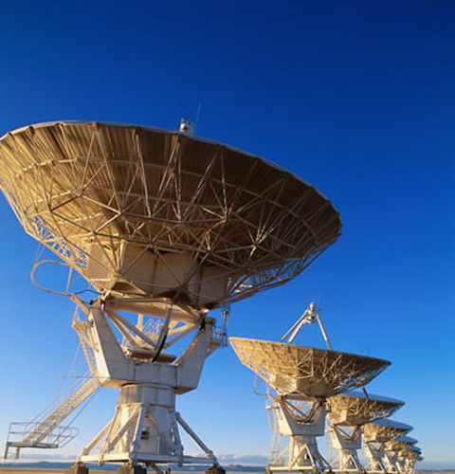
Control Segment
-Maintains and updates the space segment.
-6 Monitor Stations
-1 Master Control Station (MCS)
-4 Ground Stations/Antennas
Monitor Stations: passively track all satellites in view, accumulating range data
Master Control Station: processes the data & updates satellites’ navigation messages
Ground Stations: transmit the navigation messages to the satellites
SEANAV I United States Naval Academy
NN220 – Fundamentals of Navigation
Operations Officer I HMS PROTECTOR A173 I The Ice Patrol Ship

Slide 61
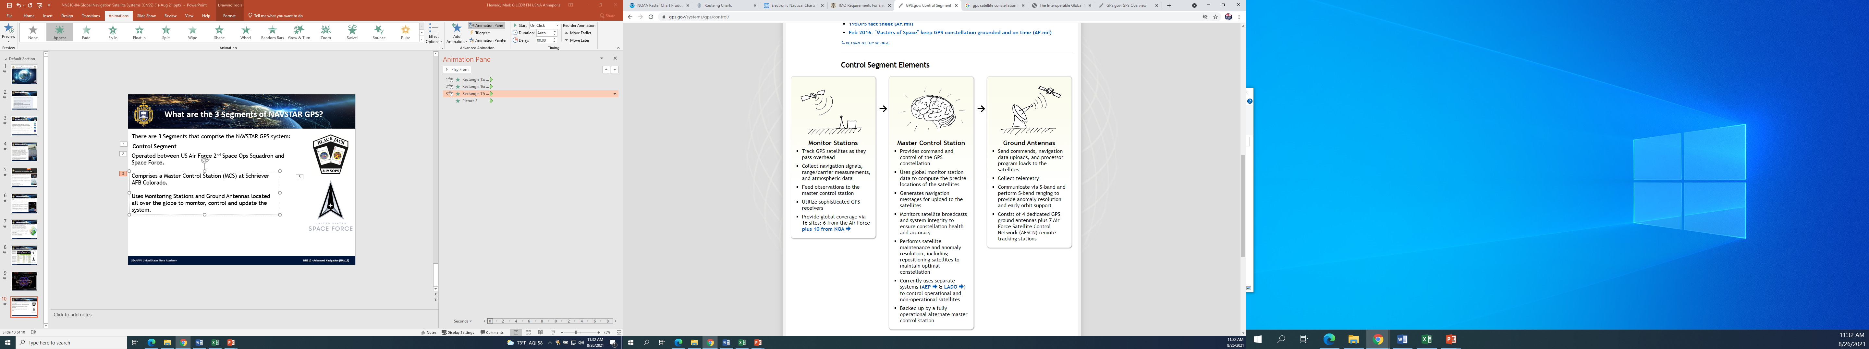
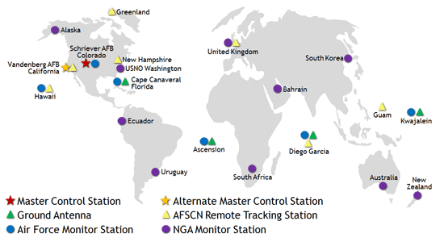

What are the 3 Segments of NAVSTAR GPS?
There are 3 Segments that comprise the NAVSTAR GPS system:
Control Segment
Operated between US Air Force 2nd Space Ops Squadron and Space Force.
Comprises a Master Control Station (MCS) at Schriever AFB Colorado.
Uses Monitoring Stations and Ground Antennas located all over the globe to monitor, control and update the system.
SEANAV I United States Naval Academy
NN310 - Advanced Navigation (NAV_2)
Operations Officer I HMS PROTECTOR A173 I The Ice Patrol Ship

Slide 62
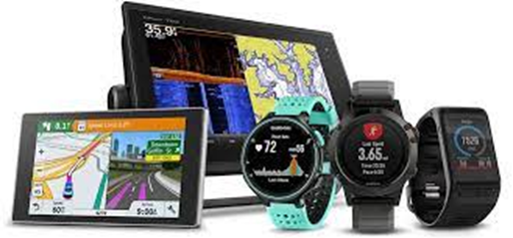


User Segment
-Any device capable of receiving GPS information.
-Cars, ships, aircrafts, drones, cell phones, watches, ATMs and much more.
-Integrated into economic markets including farming, construction, logistical supply chain.
-Critical to infrastructure including power grids, transportation, emergency services and flight safety.
-Users are Passive to the GPS system. They cannot transmit any data to the Space or Control segment.
-This provides some protection from illegal access to GPS infrastructure from hostile agents.
SEANAV I United States Naval Academy
NN220 – Fundamentals of Navigation
Operations Officer I HMS PROTECTOR A173 I The Ice Patrol Ship

Slide 63

Figure of Merit
-GPS accuracy is characterized by Figure of Merit (FOM).
-FOM is a value between 1-9 of which 1 is the most accurate GPS position and 9 the least accurate.
-FOM 1 is when GPS accuracy is better than 25m / 82ft / 27.3yds. That is, less than the distance from the bow to the 4.5inch gun.
-NAVDORM defines what FOM is required to use GPS as the primary positioning source for different types of navigation, from Restricted Water to Open Ocean.
If accuracy requirements aren’t met, GPS cannot be used.
SEANAV I United States Naval Academy
NN220 – Fundamentals of Navigation
Operations Officer I HMS PROTECTOR A173 I The Ice Patrol Ship

Slide 64
Enabling Objectives
1 – DESCRIBE E-Nav. 2 - INTRODUCE an Electronic Chart System (ECS). 3 - INTRODUCE an Electronic Chart Display Information System (ECDIS). 4 - DESCRIBE ECS performance standards. 5 - DESCRIBE ECDIS performance standards. 6 - INTRODUCE ECDIS-N. 7 - DEMONSTRATE The features of ECDIS-N. 8 - INTRODUCE What an Electronic Chart is. 9 - DESCRIBE the legal aspects of using Electronic Charts. 10 - INTRODUCE Raster Nautical Charts (RNCs). 11 - INTRODUCE Electronic Nautical Charts (ENCs) as Vector Charts. 12 - INTRODUCE Digital Nautical Charts (DNCs) as Vector Charts for the USN. 13 - DESCRIBE Integrated Bridge Systems (IBS) and Navigation Sensor System Interface (NAVSSI). 14 - DESCRIBE how to correct electronic charts to the most recent NTM and/or LNM. 15 - DESCRIBE The advantages and disadvantages of Electronic Navigation Systems, including ECS, ECDIS and ECDIS-N. 16 - UNDERSTAND the use of Time and satellites to determine a Line of Position (LOP). 17 - DESCRIBE Trilateration and the need of 3 or more LOPs to generate a GPS fix. 18 - DESCRIBE Standard Positioning Service (SPS) and Precise Positioning Service (SPS). 19 - DESCRIBE the 3 segments of GPS. 20 - DEFINE the term Figure of Merit (FOM).
SEANAV I United States Naval Academy
NN220 – Fundamentals of Navigation
Operations Officer I HMS PROTECTOR A173 I The Ice Patrol Ship

Slide 65


Questions?
SEANAV I United States Naval Academy
NN220 – Fundamentals of Navigation
Operations Officer I HMS PROTECTOR A173 I The Ice Patrol Ship

